Slide 1

Windows 2000 Networking
Computing Department,
Lancaster University, UK

Slide 2
Overview
The OSI Reference Model
Overview of the Windows 2000 Networking Stack
  Services
  Networking APIs
  Protocol Drivers
  NDIS Drivers
Some detail on Winsock2

Slide 3
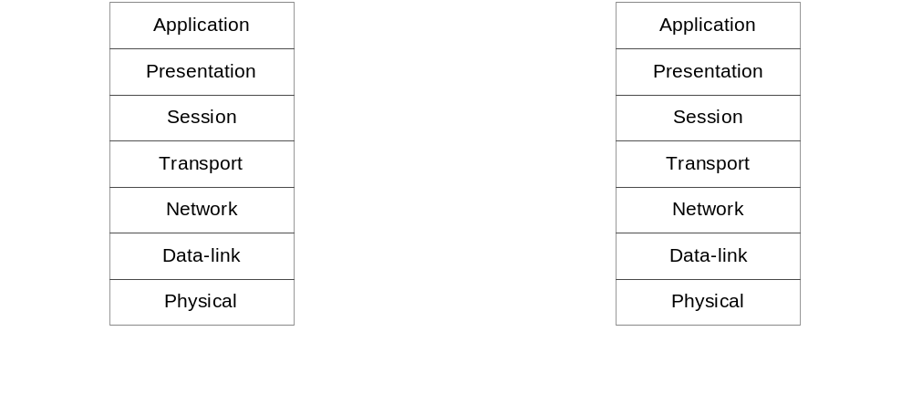
The OSI Reference Model
Idealized scheme, often used to frame discussions of networking principles
  (few systems implement precisely)

Slide 4
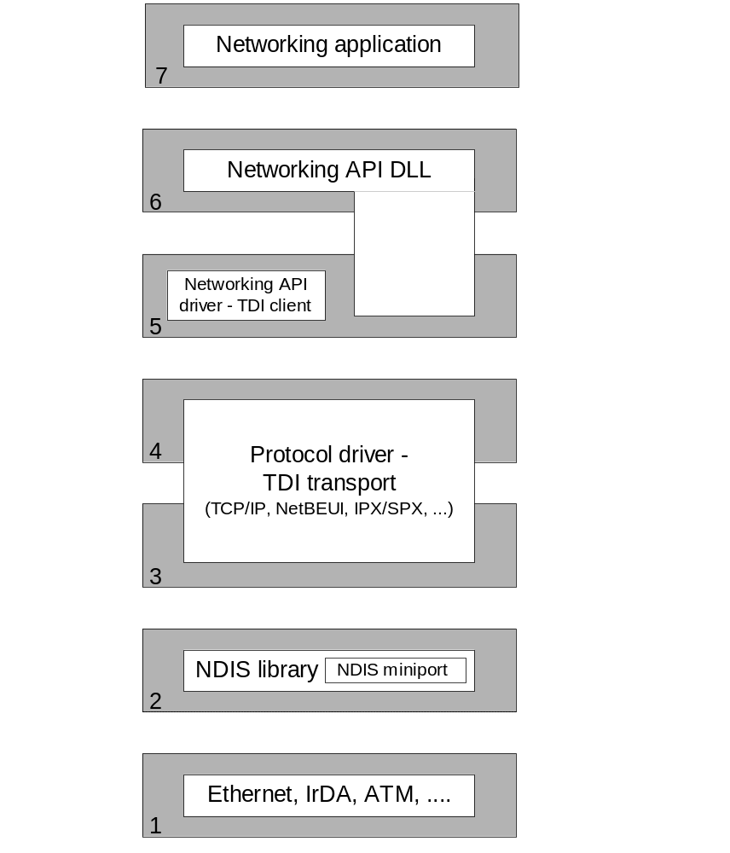
OSI Model and Windows 2000 Networking Components
OSI layers don’t correspond to actual software
Bottom 4 layers are “the transport”
Top 3 layers are the “user of the transport”

Slide 5
OSI Model and Windows 2000 Networking Components (2)
Networking APIs (layers 5 / 6)
  Provide protocol-independent way for applications to communicate across a network
  Can be implemented in user mode or in both user mode and kernel mode
Transport Driver Interface (TDI) Clients (layer 5)
  Kernel-mode device drivers that implement the kernel-mode portion of a networking API’s implementation
  Use TDI standard to format I/O request packets sent to protocol drivers

Slide 6
OSI Model and Windows 2000 Networking Components (3)
TDI Transports (layers 3 / 4)
  Also known as protocol drivers
  Accept I/O request packets from TDI clients
  Likely to require network communications
    Addition of protocol-specific headers (e.g. TCP, UDP, IPX)
    Communicate with adapter drivers using NDIS functions
  Often transparently perform:
    Segmentation and reassembly
    Sequencing
    Acknowledgement
    Retransmission

Slide 7
OSI Model and Windows 2000 Networking Components (4)
NDIS Library (layer 2)
  Provides encapsulation for adaptor drivers
    Hiding from specifics of kernel-mode environment
  Exports functions for use by TDI transports, using NDIS - Network Driver Interface Specification
    Describes the interface that network adapter drivers use to communicate with underlying hardware
NDIS Miniport drivers (layer 2)
  Kernel-mode drivers responsible for interfacing TDI transports to particular network adapters
  Wrapped by NDIS library, to work “cross platform”
  Communicate with network adapters using NDIS library functions that resolve to HAL functions

Slide 8
The Windows 2000 Networking Stack
Services
Networking APIs
Protocol Drivers
NDIS Drivers

Slide 9
The Windows 2000 Networking Stack: Services (1)
Remote Access
  Available on Windows 2000 Server
  Allows clients to connect to remote access servers, as if client were physically connected to the server’s network
    Provides access to network resources, files, printers etc.
  Two types of remote access:
    Dial-up remote access
    Virtual private network (VPN) access (virtual point-to-point connection to the server)

Slide 10
The Windows 2000 Networking Stack: Services (2)
Active Directory
  Windows 2000 implementation of Lightweight Directory Access Protocol (LDAP) directory services
  Based on a database that stores objects representing resources defined by applications in a Windows 2000 network
    e.g. structure and membership of a domain, including user account and password information
File Replication Service
  Allows for distributed multimaster replication…
  Changes are propagated to members
  Primarily used by domain controllers

Slide 11
The Windows 2000 Networking Stack: Services (3)
Network Load Balancing
  Allows the creation of a cluster containing up to 32 computers (cluster hosts)
  Cluster maintains a single virtual IP address
    Client requests go to all computers
    Only one replies…
  Load balancing NDIS drivers effectively partition client space among available hosts
  Does not include services for automatically distributing shared state
    Application must have access to shared state
  Ideal applications
    Web server serving static content, windows media server etc...

Slide 12
The Windows 2000 Networking Stack: Networking APIs (1)
Windows Sockets (Winsock)
  Microsoft’s implementation of BSD sockets
    Supports both reliable-connection-oriented and unreliable-connectionless communication
    Windows 2000 provides support for Winsock2 – (more later)
Named pipes and mailslots
  Named pipes: reliable bi-directional communication
  Mailslots: unreliable uni-directional transmission
    Supports broadcast capabilities
  Both support Windows 2000 security
    Allows servers to control which clients can connect
  Supports Universal Naming Convention (UNC)
    Protocol-independent naming…

Slide 13
The Windows 2000 Networking Stack: Networking APIs (2)
Remote procedure call (RPC)
  Developed 1980’s…
  Part of the OSF/DCE standard
NetBIOS
  Network Basic Input/Output System (NetBIOS) programming API
  Until the 1990’s most common programming API
  Supported in Windows 2000 for legacy apps
    Supported by TCP/IP, NetBEUI, IPX/SPX etc…
  Microsoft discourages use…

Slide 14
The Windows 2000 Networking Stack: Other Networking APIs
Telephony API
  Integrates computers with communications devices such as telephones and modems
  APIs for device, session and media control
DCOM
  “on the wire” protocol for COM
  DCOM extends COM by letting an applications components reside on different computers
Message Queuing
  An API and messaging infrastructure
  General purpose platform for applications that take advantage of loosely coupled messaging
  Queues serve as message repositories
    Senders can queue messages for receivers, receivers can de-queue at their discretion

Slide 15
The Windows 2000 Networking Stack: Protocol Drivers (1)
Purpose
  Networking API drivers take requests and translate them into low-level network protocol requests
    Transport drivers carry out translation
  Separation allows support for multiple protocols
Protocol drivers supported by Windows 2000
  Data Link Control (DLC)
    Primitive protocol used by IBM m/fs and some HP printers
    “raw” – no networking API exists – applications interface directly to protocol driver
  NWLink
    Consists of Novell’s IPX and SPX protocols
    Included to support interoperability with NetWare servers

Slide 16
The Windows 2000 Networking Stack: Protocol Drivers (2)
Protocol drivers supported by Win 2000 (cont.)
  NetBEUI
    Once the default for LAN Manager and NetBIOS API
    Limited – not routable
    Included in Windows 2000 to support legacy applications
  TCP/IP
    Predominant protocol in Windows 2000
    Developed as the foundation for the Internet, WAN-friendly characteristics
    Only primary protocol installed by default
    Driver implements TCP, UDP, IP, ARP, ICMP etc…
Other drivers may be supported, for example:
  ATM
  AppleTalk

Slide 17
The Windows 2000 Networking Stack: NDIS Drivers (1)
Purpose
  Network adaptor vendors provide device drivers that can take network messages and transmit them via proprietary hardware
    Network Driver Interface Specification (NDIS) lets protocol drivers communicate with network adaptor drivers
  NDIS 5 ships with Windows 2000
NDIS 5 Features:
  TCP/IP task offloading – allows a NDIS miniport to use advanced features of network adapter
    e.g. packet checksums, and IPSec
    Helps to improve system performance – relieves CPU
  NDIS drivers can report whether or not network medium is active – taskbar icon…

Slide 18
The Windows 2000 Networking Stack:
NDIS Drivers (2)
NDIS 5 Features (cont.):
  Fast packet forwarding – network adapter routes packets not destined for computer, relieving CPU
  Wake-on-LAN – allows capable network adapter to bring Windows 2000 out of a suspended power state
    Triggered by media connections, receipt of protocol-specific patterns, the receipt of a magic packet, etc…
  Connection-oriented NDIS – allows NDIS drivers to support connection oriented media such as ATM
    Addition of connection-oriented miniport driver
    NDIS drivers send packets through established network connections rather than placing them on the network medium
    Call manager NDIS driver provides call control functionality

Slide 19
More Detail on Winsock2
Winsock2 API provides a transport service interface
  Based around BSD Unix socket interface / paradigm
    (adopted for use by Microsoft for use within Winsock 1.1)
  Transparent network programming
    Application need not be aware of underlying implementation
  Winsock2 provides only an interface
    Allows for the provision of interaction with numerous underlying heterogeneous transport protocols
    Existence of both the API and SPI

Slide 20
Winsock2 Features (1)
Access to protocols other than TCP/IP
  Access to a number of installed transport protocols, using familiar socket interface
  Includes protocol-specific extension mechanisms…
Layered protocols
  Support for protocols that cannot stand alone, and therefore rely on a base protocol
Protocol-independent name resolution facilities
  Standardised set of functions for querying and working with the range of name resolution mechanisms that exist today (e.g. DNS, X.500 etc.)

Slide 21
Winsock2 Features (2)
Protocol-independent multicast and multipoint
  Applications discover what type of capabilities a transport provides, and uses these in a generic manner
Quality of Service
  Establishes conventions that applications use to negotiate required service levels
  Supports parameters such as bandwidth and latency
  Supports network-specific QoS extensions…
Others
  inc. backwards compatibility

